Slide 1
Face Recognition
Shreenidhi Sudhakar

Slide 2
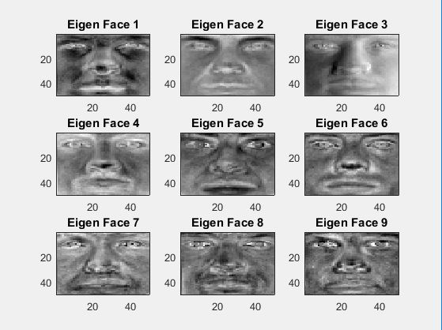
Principle Component Analysis
Faster Training
Pre Processing Step
Dimensionality Reduction
Eliminate redundant data

Slide 3
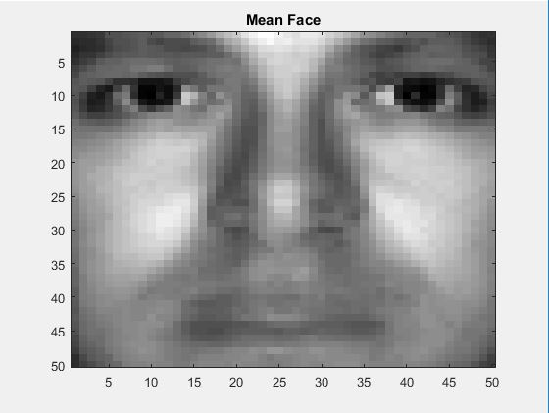
Results

Slide 4
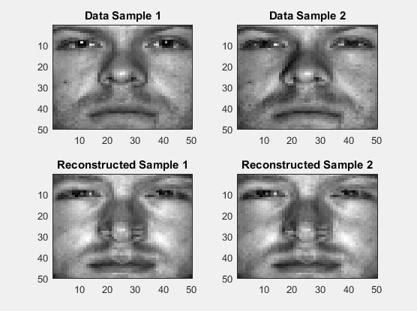
Results
Reconstructed Input = Mean Face + Projected Input * Eigen Vector(1:M)‘
M = # of Principal Components

Slide 5
Real Time Application
Neuroscience
Interest Rate Derivatives Portfolios

Slide 6
Thank You
Check Out: shreenidhi.azurewebsites.net

